Slide 1
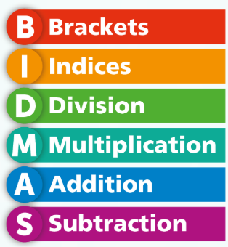
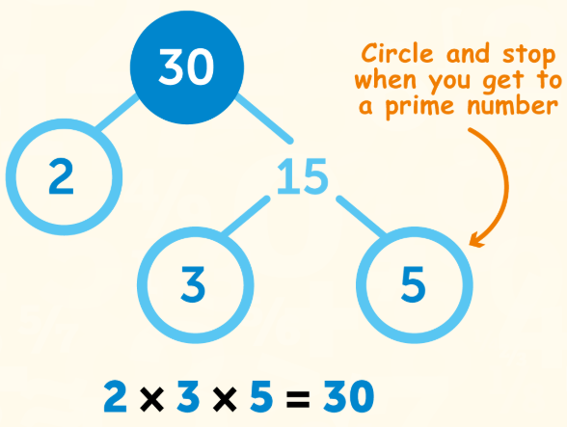
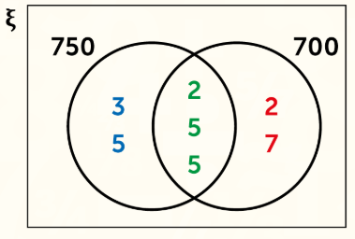
WBS Maths Knowledge Organiser
unit 1 - number
Use priority of operations (BIDMAS) with integers. | Work with factors and multiples, including HCF and LCM.
Round answers to the given accuracy (decimal place/ significant figure) | Find HCF and LCM using prime factor decomposition.
Multiply and divide with decimals. | Find square and cube numbers and find their equivalent roots.
Use the laws of indices.
Keywords
Operation, Inverse, Order, Round, Approximately, Estimate, Significant, Place Value, Prime, Square, Root, Indices, Index
BB
BB
Significant Figures
BIDMAS
Laws of Indices
Multiply: Add powers
Divide: Subtract powers
Brackets: Multiply powers
HCF and LCM
Prime Factor Decomposition
Rounding to decimal places
HCF
LCM
HCF and LCM for large numbers
HCF
LCM
Corbett Maths Clip
Hegarty maths
211-230
17, 28, 56, 99, 100, 133

