Slide 1
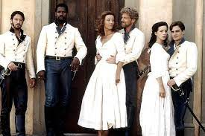
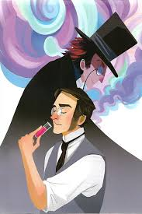
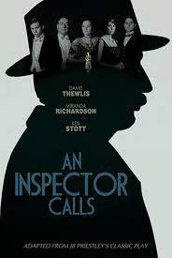
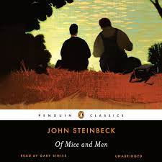
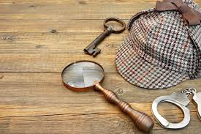
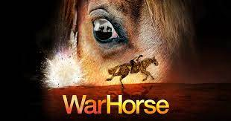
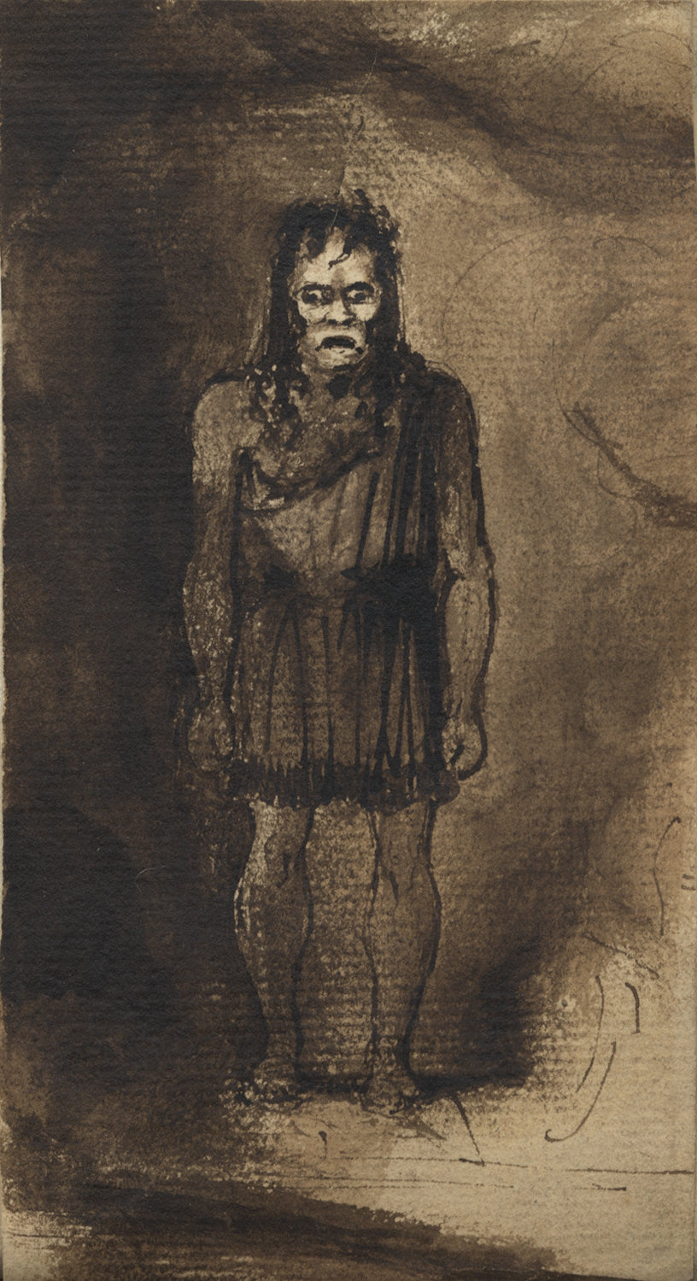
English Curriculum Map Summary: Year 7-11
6. Reading: Language Paper 1
7. Writing: Paper 1
8. Mock exam. Language Paper 1 and Lit. Paper 2
7. Revision of Lit. Jekyll and Hyde
9. Revision of Poetry – anthology and unseen
10. Revision of Much Ado
11. Revision of An Inspector Calls
12. Mock exam. Lit Paper 1
13. Revision of Language Paper 1
14. Revision of Language Paper 2
5. Lit. Complete/ revise poems
3. Reading (writing) Paper 2
4. Language Paper 2 Mock
SIT GCSE ENGLISH LANGUAGE AND GCSE ENGLISH LITERATURE
Lit: Much Ado About Nothing
Much Ado – Study Guide
YEAR
15. Lit. Intro to Much Ado
14. Mock Language: Paper 2
13. Mock Lit. Paper 1
11.. Reading: Language Paper 2
12. Writing: Paper 2
10. Literature: Dr. Jekyll and Mr. Hyde
11. Dr J and Mr H – Study Guide
8. Lit: Unseen Poetry
9. Lit – 4 Anthology poems
7. S and L: Individual Presentation
11
6.Writing: Based on Poetry
5. Literature: Study of Poetry – 4 poems
3. Reading: Language Paper 2
4. Writing: Language Paper 2
Lit. An Inspector Calls
An Inspector Calls Study Guide
5. Writing – Romeo and Juliet
6. Reading: Modern Prose Extracts
7. Study of Non-fiction: Bias and Reliability
8.. Reading: The Romantics
9. Writing: Based on Romantic Poetry
10. Reading: Of Mice and Men
YEAR
4. Writing: Detective Fiction
10
3. Reading: The Speckled Band
START OF KS4
2. Writing: Speeches + S and L.
END OF KS3
1. Reading: Non-fiction Speeches
YEAR
12. Playscript for Pleasure
11. Reading: Study of Modern Prose
10. Writing: Formal Letter
9. Reading and writing: Macbeth
8. S and L: Dragons’ Den
9
7. Writing: Travel
6. Changing Language
5. Non-fiction reading and writing – newspaper report
4. Writing: Christmas ghost story
10. Personal and Reflective writing based on the novel
11. Study of Poetry and S and L assessment
12. Playscripts for fun
YEAR
1. Study of Drama and Poetry: WW1 and War Horse
2. Writing: Transformation of WW1 Poetry
3. Reading: Pre 20th C Ghost Stories.
8
9. Reading: Study of Modern Prose
Key - non-fiction
Key - Poetry
8. Reading: Shakespearean Villains
Key - fiction
Key – Pre 20th Century
7. S and L: Science and Ethics
Key – Speaking and Listening
Key - Project
6. Descriptive writing: Behold the Monster!
5. Reading: Study of Gothic Drama, Frankenstein
4. Transactional Writing: Animal Campaign
3. Reading: Non-fiction Adverts
2. Reading: Study of Other Cultures
1. Transactional Writing: Pen Portrait
YEAR
7

