Slide 1
Languages help you to listen, understand and express yourself in the wider world.
Intent:
Intent : Spanish helps you to listen, understand and express yourself in the wider world.
Year 7 French and Spanish Learning Journey
On to YEAR
Weather
Sporting activities
Hobbies
8
Mon temps libre
In the Summer term, you will continue learning French, finding out about school life and popular sports in French-speaking countries
PHONICS
FRENCH
School uniform
School subjects
En classe
Telling the time
School day
You will write a French poem about the activities you like and don’t like doing, using a bilingual dictionary to help you to look up new words
VOCAB
Likes and dislikes
Brothers and sisters
In the Spring term, you will be learning French, building on the work you have been doing at primary school
Describing personality
Key French phonics
Numbers, age, dates
Introducing yourself
La rentrée
GRAMMAR
You will find out about popular names in Spain, Spanish celebrities, Spanish speaking countries, Spanish tapas, prices in euros, Spanish speaking towns, Spanish festivals (Navidad - Christmas)
Describing a town
Ordering in a café
In the Autumn term, you will be learning Spanish so that you can get by when visiting a Spanish-speaking country
SPANISH
Introducing yourself
Greetings
Key Spanish phonics
Start
YEAR
7
Set yourself up on Memrise and Linguascope to help you learn

Slide 2
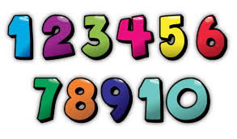
Intent:
Intent : Spanish helps you to listen, understand and express yourself in the wider world.
Year 8 Spanish Learning Journey
On to YEAR
9
Describing your school
Finding your way around a town
Shopping for souvenirs
PHONICS
Mi insti
Survival Spanish
Describing your school day
Giving opinions about school subjects
Talking about what you wear
Describing how you get ready to go out
¿Qué hacemos?
VOCAB
Saying what you are going to do at the weekend
Arranging to go out
Making excuses
Telling the time
Mi ciudad
Mi familia y mis amigos
Describing towns and cities
Describing where you live
Describing family members
Spanish festivals
Saying which activities you do on different days
GRAMMAR
Mi tiempo libre
Using the alphabet to spell in Spanish
Language for the classroom
Saying what you like to do
Talking about the weather
Talking about your brothers and sisters
Mi vida
Numbers
Talking about your age and birthday
Talking about your personality
Introducing yourself
Start
YEAR
8
Articles, adjectives and agreements, connectives, intensifiers, infinitive verbs, present tense of regular and common irregular verbs, future and conditional tenses

Slide 3
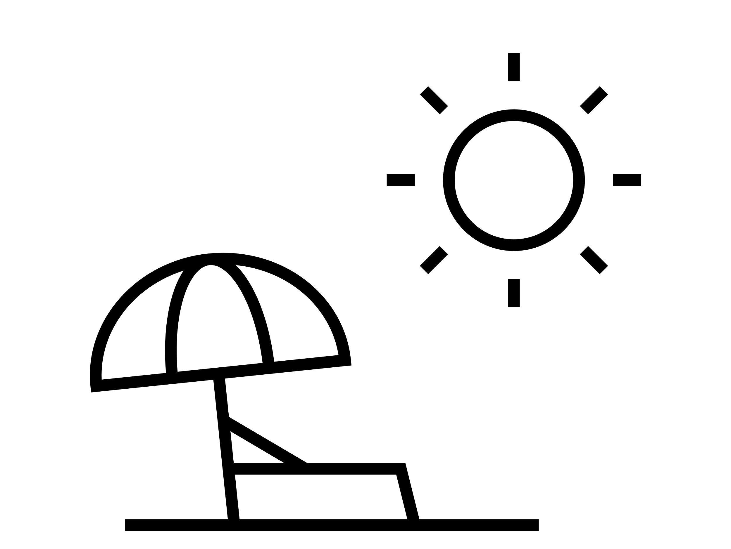
Intent: Spanish helps you to listen, understand and express yourself in the wider world.
Intent : Spanish helps you to listen, understand and express yourself in the wider world.
Year 9 Spanish Learning Journey
On to
YEAR
Dealing with llness and injury
Interacting in real life situations in Spanish speaking countries
10
PHONICS
Survival Spanish
Finding food
Finding accommodation
Talking about international issues and fundraising
Talking about what we do to help the environment
Comparing how children travel to school
Jóvenes en acción
VOCAB
Describing a typical day and what you did yesterday at work
Describing the lives of children in other parts of the world
Talking about the rights of the child
Saying what tasks people do in their job
Oriéntate
Talking about career choices
Describing birthday celebrations
Giving opinions
Saying what you did yesterday
GRAMMAR
Todo sobre mi vida
Saying what you watch on tv and at the cinema
Buying meals in a restaurant
Shopping for food
Talking about how you use your phone
Saying what music you like
Saying what you eat for different meals
A comer
Mis vacaciones
Giving opinions on food
Saying where you stayed, what you did
Describing a past holiday
Start
YEAR
9
Consolidation of Year 8 structures and past preterite tense of regular and irregular verbs, combining 3 tenses, comparatives and superlatives, negatives informal and formal verb forms, transactional structures.

Slide 4
Intent: Spanish helps you to listen, understand and express yourself in the wider world.
Intent : Spanish helps you to listen, understand and express yourself in the wider world.
Year 11 Spanish Learning Journey
On to
YEAR
Listening exam
Reading exam
Writing exam
12
PHONICS
GCSE Speaking exam (role play, photo and general conversation)
GCSE Spanish
Exam practice with past papers
Revision of GCSE topics
Repaso
The importance of international events
VOCAB
Talking about local issues and taking action
Environmental problems and natural disasters
Healthy eating and healthy lifestyles
Hacia un mundo mejor
Talking about global issues
Talking about plans for the future
Applying for a job
Saying why languages are important
GRAMMAR
A currar
Describing your experiences of work
Describing a music festival
Saying what you do to help at home
Saying what job you are going to do
Eating out
De costumbre
Describing festivals and special days
Talking about food and mealtimes
Start
YEAR
11
Consolidation of structures from Year 10 and reflexive verbs, the passive, present subjunctive, pluperfect and imperfect continuous tenses.

Slide 5
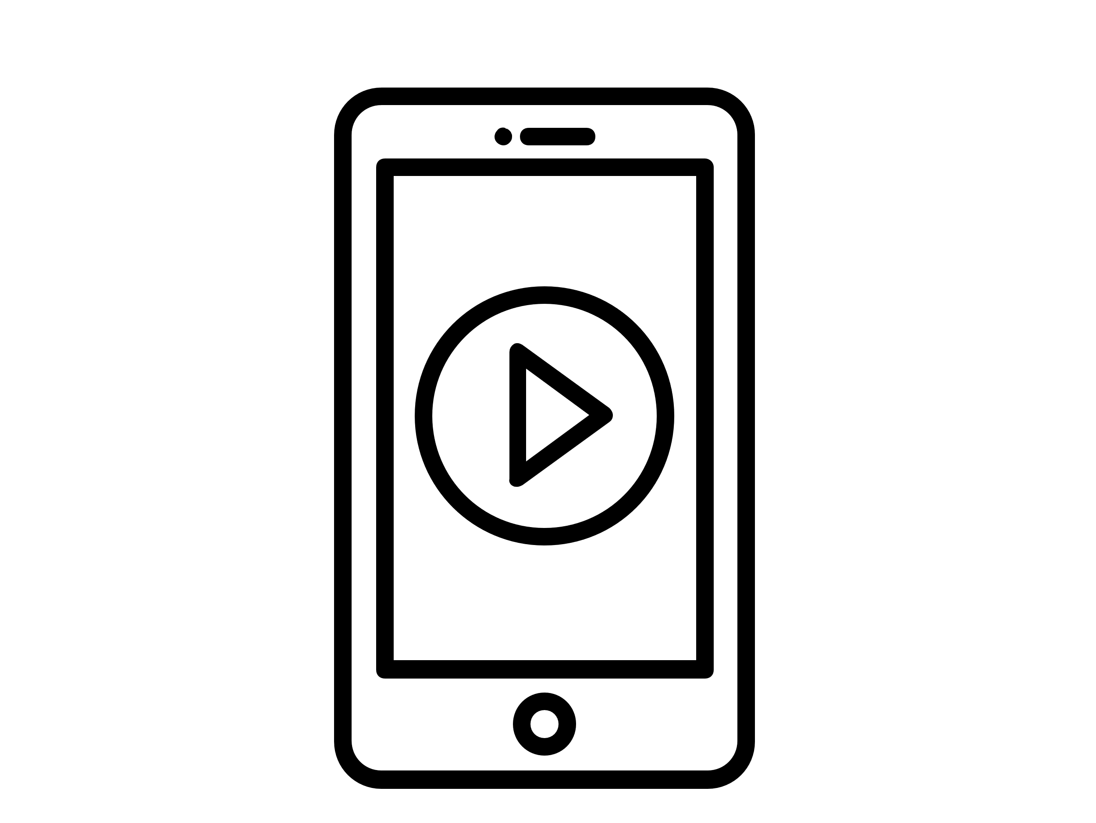
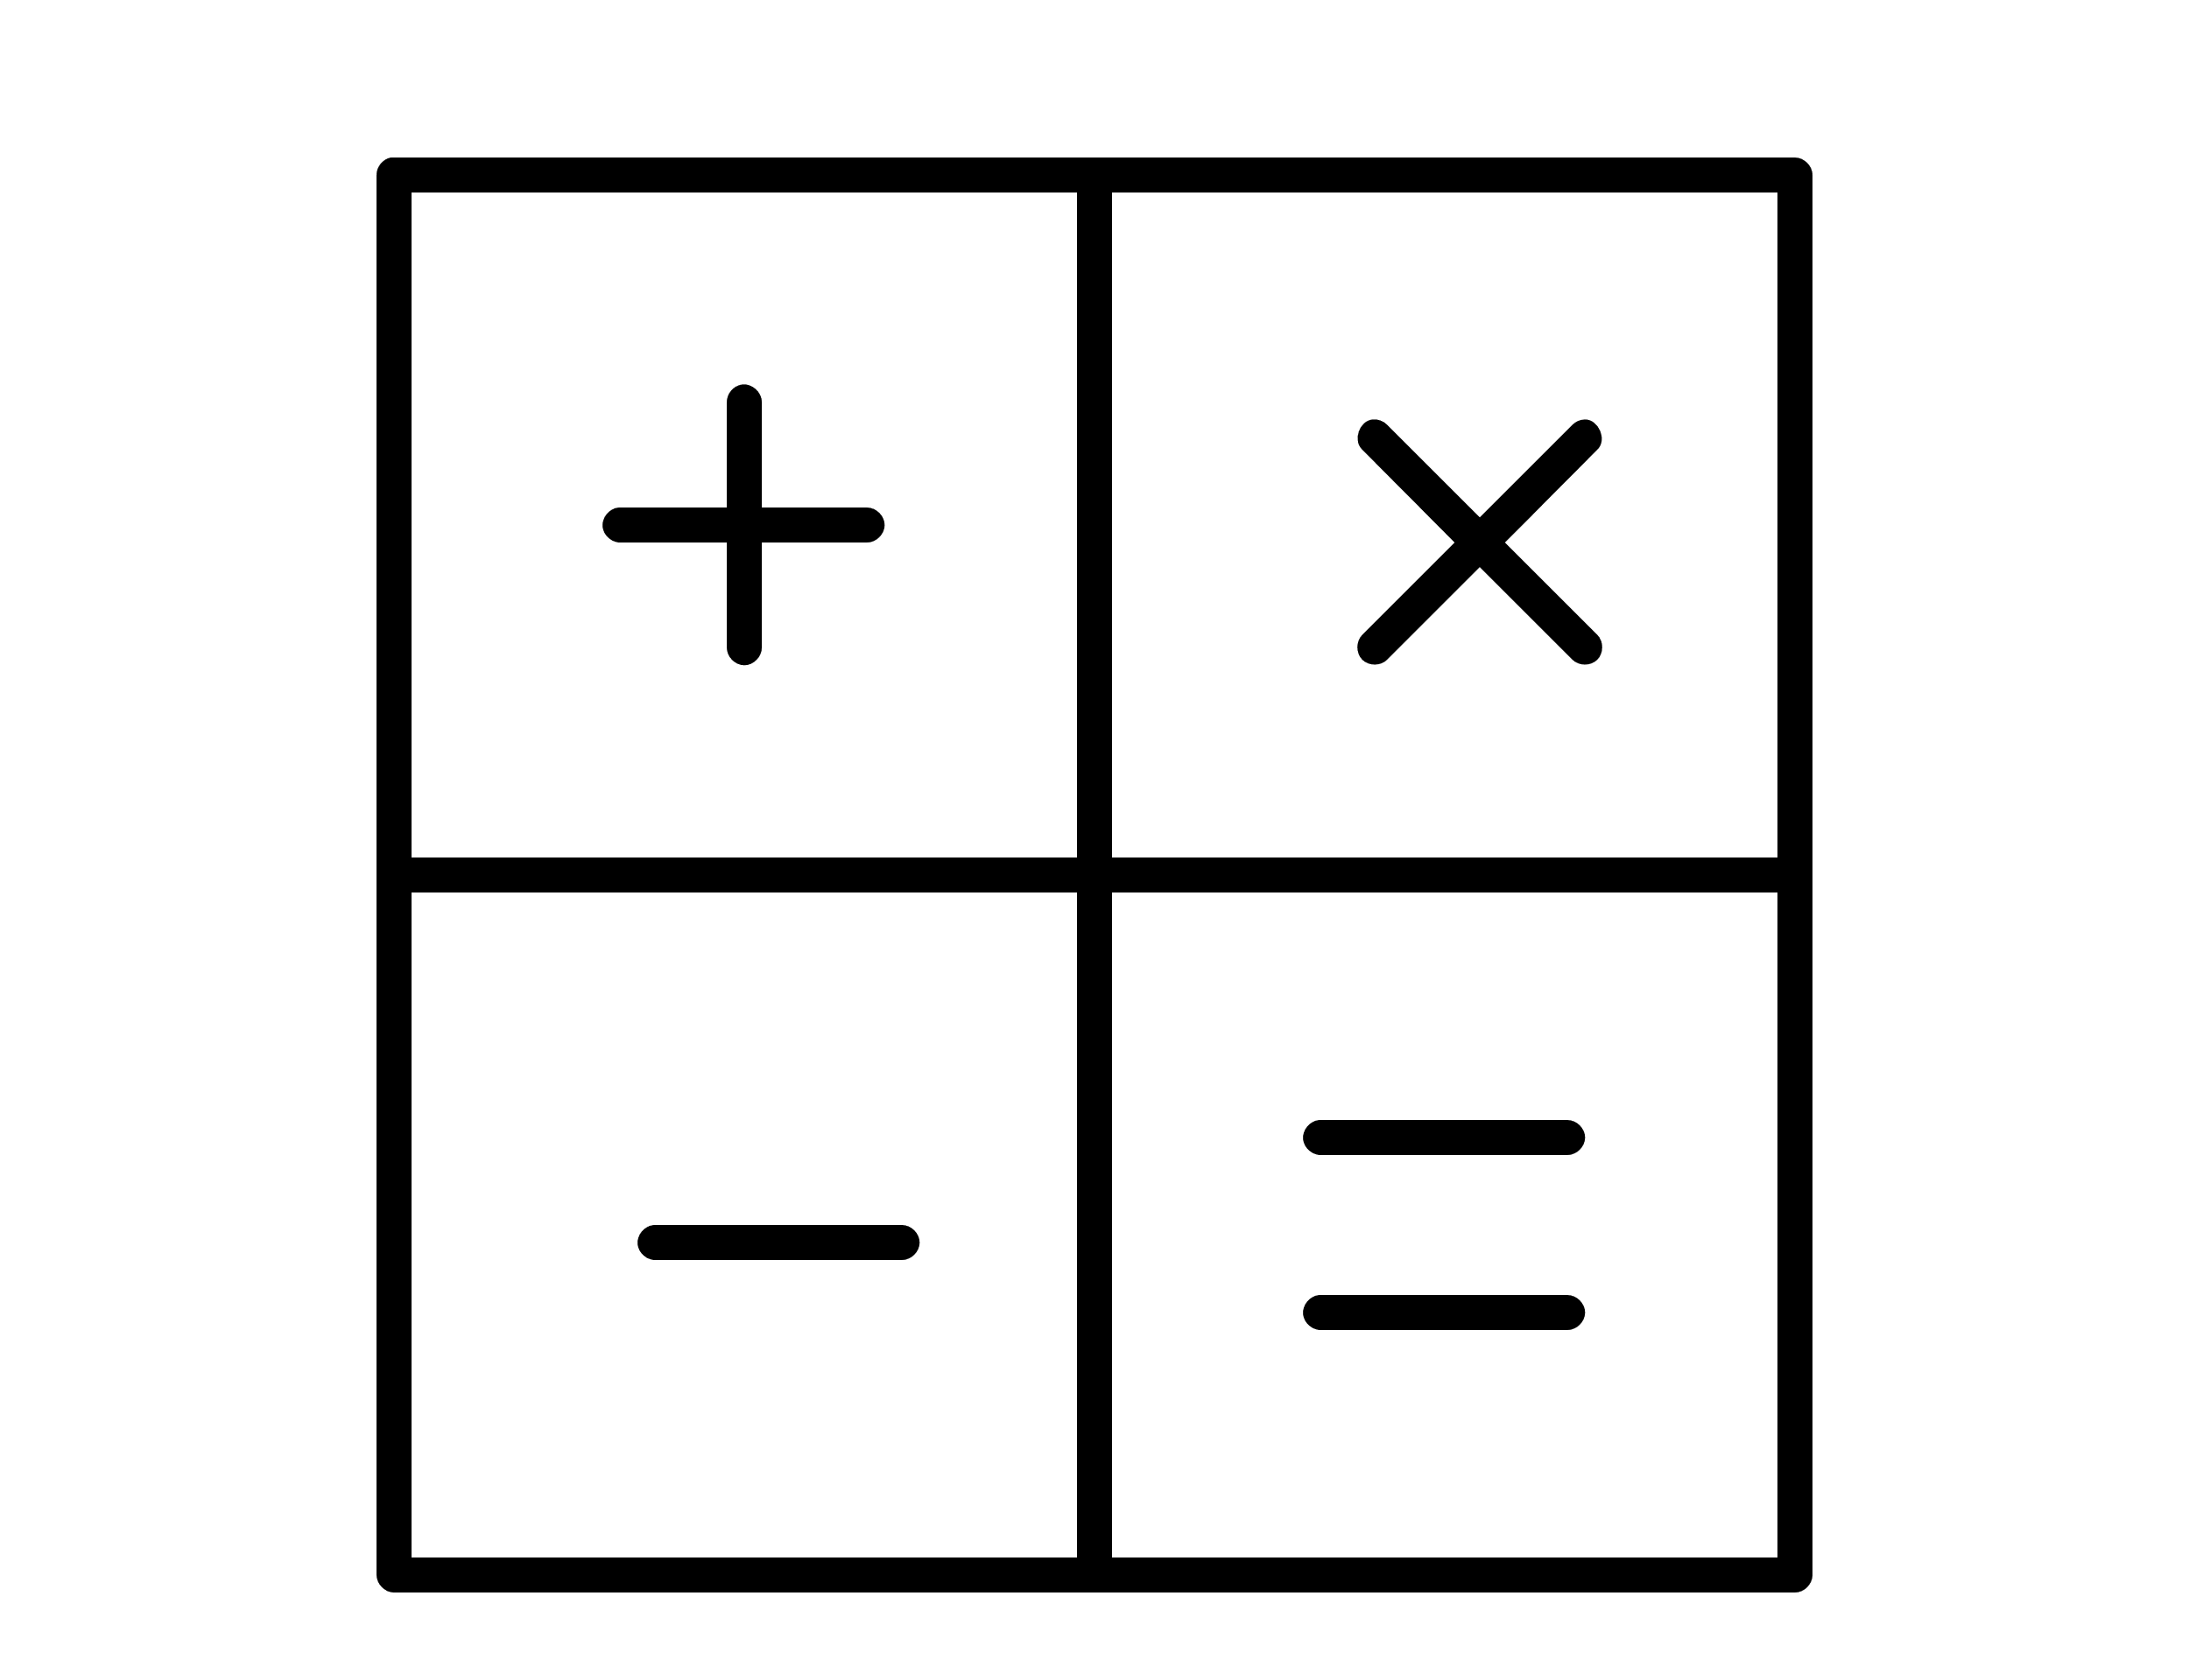
Intent: Spanish helps you to listen, understand and express yourself in the wider world.
Intent : Spanish helps you to listen, understand and express yourself in the wider world.
Year 10 Spanish Learning Journey
On to
YEAR
Planning excursions and describing past visits
Shopping for clothes and presents
The pros and cons of living in a town or the country
11
PHONICS
Describing town and region
Ciudades
Discussing role models
Talking about tv, film and entertainment
Talking about what sports you do
Intereses e influencias
Saying what you usually do
VOCAB
Saying how you use technology
Talking about reading habits
Talking about freetime activites
Mi gente
Talking about relationships with family and friends
Describing your family members
Talking about after school clubs
Planning an exchange visit
GRAMMAR
Mi vida en el insti
Giving opinions about school rules
Saying what you study in school
Giving opinions about uniform
Describing school facilities
Describing past holidays
Desconéctate
Giving opinions about different holidays
Talking about holiday activities
Start
YEAR
10
Present, present continuous, past preterite, perfect, imperfect, future and conditional tenses of regular and irregular verbs, questions, negatives, pronouns, adjectives and agreements

