Slide 1
KS3 Sciences in years

Slide 2
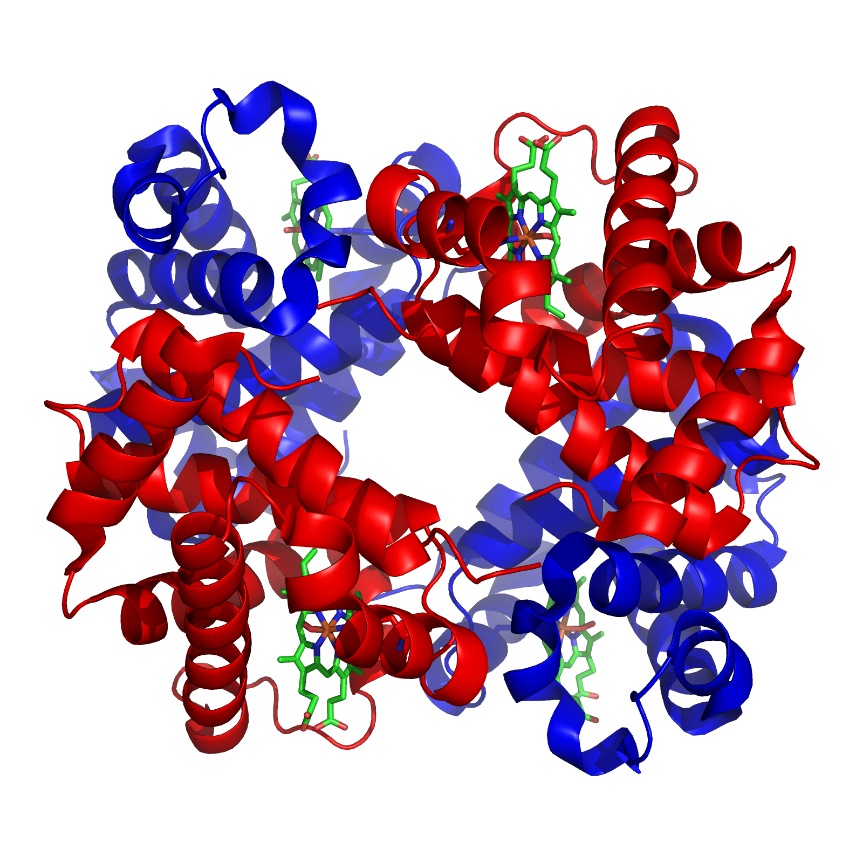
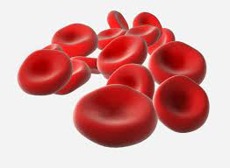
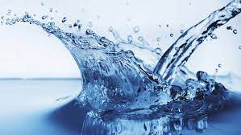
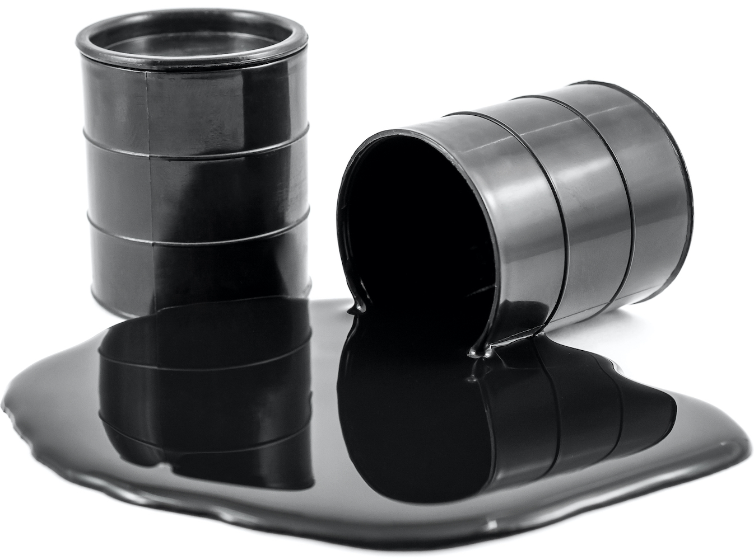
Intent: Making the world go round with learning for today, tomorrow and the future
Science Year 9 Learning Journey
YEAR
10
GCSE Energy Resources
Energy usage and how it is affected by political, economic and scientific issues. The environmental impact of using energy, how renewable and non-renewable energy sources and the advantages and disadvantages of using them
GCSE Earth’s Resources
Blood and circulatory system, the
respiratory system, CHD, cancer and
non-communicable diseases and
medical treatments.
How chemists seek to minimise the use of limited resources such as energy and water, managing the environmental impact of human activity.
GCSE Circulation and Health
Practical Skills
Applying different physical methods to separate different types of mixtures including an in depth look at the chemicals obtained from separating crude oil.
Understanding decimals, SI units, Graph drawing, calculating means, rearranging equations, variables, range and resolution.
Separating Mixtures
Photosynthesis, respiration, limiting
factors, diffusion, surface area-volume
ratios and lung health.
YEAR
Biological Processes
9

Slide 3
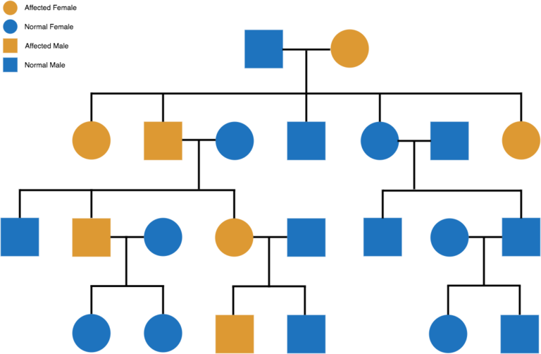
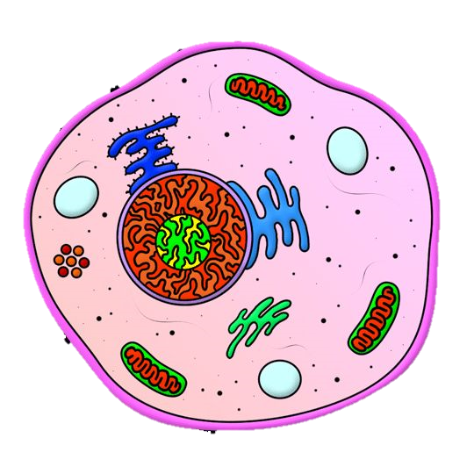
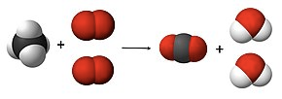
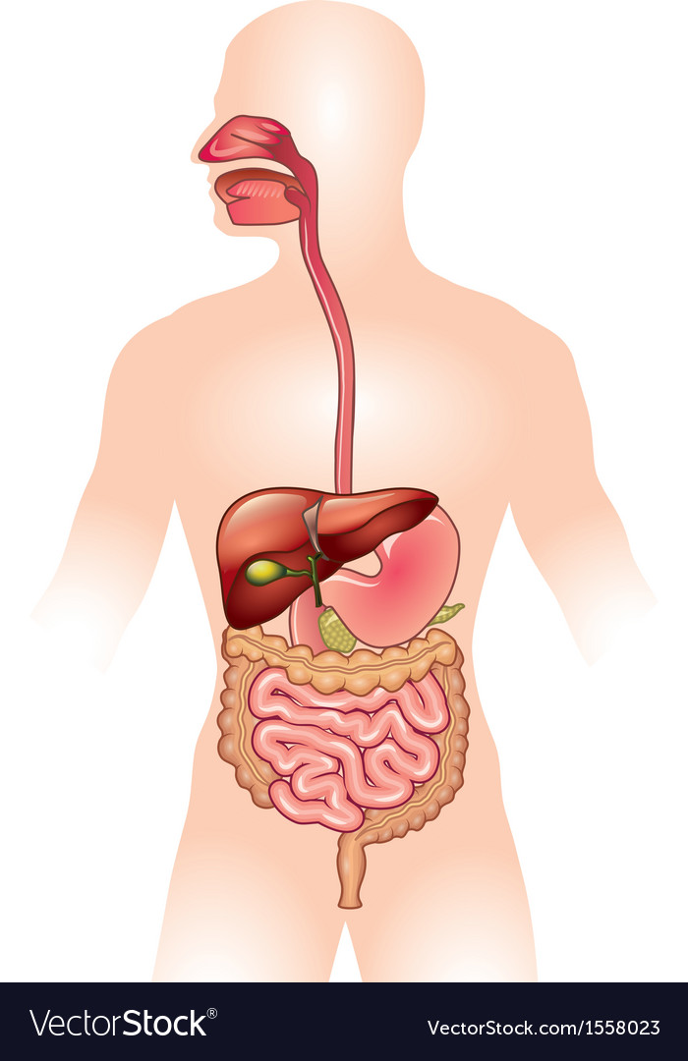
Intent: Intent: Making the world go round with learning for today, tomorrow and the future
Science Year 8 Learning Journey
On to
YEAR
9
Waves
Sound, frequency, amplitude, how we hear, light, colour, reflection and refraction.
The Earth
DNA and Evolution
How science and geography
combine, how rocks and the atmosphere develop.
Genetics, inheritance, mutations,
natural selection, evolution,
evidence and fossils.
Forces
Types of forces, weight, mass, friction, resultant forces, how planes fly, magnets and making electromagnets.
Acids and Metals
Reproduction
Acids and alkalis: how we identify them, how they react and the patterns they show.
Pollination, fertilisation, seed dispersal, female and male human reproduction.
Chemical reactions
Different types of reactions and how we write them as equations.
Start
YEAR
Nutrition
8
Keeping a balanced die, health impacts, the digestive system, and enzymes.

Slide 4
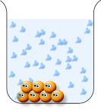
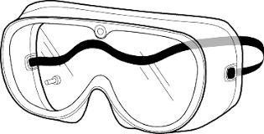
Intent: Making the world go round with learning for today, tomorrow and the future
Science Year 7 Learning Journey
On to
YEAR
8
Temperature and Energy
How to use a thermometer, state changes, expansion, heat, conduction, convection and radiation.
Elements, Compounds and Mixtures
Materials and the periodic table, element symbols. How we separate mixtures.
Organism interactions, and human
impacts, genetics introduction.
Energy and Electricity
Interdependence and Variation
Types of energy stores and how energy is transferred. Making electrical circuits, light bulbs and lighthouse challenge.
Particles and Matter
What is everything made of and how it behaves. How dissolving works.
Animals and plants, cells and organisms, viewing structures and functions.
Cells and Organisation
Working Like a Scientist
Working safely, using a Bunsen, choosing variables, drawing graphs, completing experiments
Start
YEAR
Space, Forces, Light and Electricity
Properties of materials, The Earth
YEAR
7
Genetics, Humans and Habitats
5-6

Slide 5
KS3 Science (whole)

Slide 6
Intent: Making the world go round with learning for today, tomorrow and the future
Science KS3 Learning Journey
YEAR
10
GCSE Circulation and Health
GCSE Earth’s Resources
GCSE Energy Resources
Blood and systems, non-communicable
diseases and treatments.
How chemists seek to minimise the use of limited resources such as energy and water, managing the environmental impact of human activity.
Energy usage and how it is affected by political, economic and scientific issues. Renewable and non-renewable energy sources and the advantages and disadvantages.
Practical Skills
Separating Mixtures
YEAR
Biological Processes
9
Understanding decimals, SI units, Graph drawing, calculating means, variables, range and resolution.
Applying different physical methods to separate different types of mixtures including an in depth look at the chemicals obtained from separating crude oil.
Photosynthesis, respiration, limiting factors, diffusion.
Sound, frequency, amplitude, how we hear, light, colour, reflection and refraction.
Acids and Metals
The Earth
Forces
Waves
Acids and alkalis: how we identify them, how they react and the patterns they show.
How science and geography
combine, how rocks and the atmosphere develop.
Types of forces, weight, mass, friction, resultant forces, how planes fly, magnets and making electromagnets.
Keeping a balanced die, health impacts, the digestive system, and enzymes.
Chemical Reactions
DNA and Evolution
Reproduction
Nutrition
Different types of reactions and how we write them as equations.
Genetics, inheritance, mutations, natural selection, evolution, evidence and fossils.
Pollination, fertilisation, seed dispersal, female and male human reproduction.
YEAR
8
Elements, Compounds and Mixtures
Energy and Electricity
Temperature and Energy
Particles and Matter
What is everything made of and how it behaves. How dissolving works.
Materials and the periodic table, element symbols. How we separate mixtures.
Types of energy stores and how its transferred. Making electrical circuits, light bulbs and lighthouse challenge.
How to use a thermometer, state changes, expansion, heat, conduction, convection and radiation.
YEAR
Interdependence and Variation
Cells and Organisation
Working Like a Scientist
7
Organism interactions, and human impacts, genetics introduction.
Animals and plants, cells and organisms, viewing structures and functions.
Working safely, using a Bunsen, choosing variables, drawing graphs, completing experiments

Slide 7
KS4 Sciences
(separated by course)

Slide 8
Intent: Understanding the natural world today, so we can develop new ideas for the future.
Separate Physics KS4 Learning Journey
YEAR
12
GCSE Electromagnetism
GCSE Space
How magnets work, motor effect, magnetic fields, generators, transformers.
Formation solar system, star life cycle, orbit and satellites; red shift and dark matter.
GCSE Waves
GCSE Pressure
Wave types, wave properties, EM spectrum; its uses and dangers. Reflection, refraction, seismic waves and ultra-sound.
Surface pressure, atmospheric pressure, fluid pressure, work on a gas.
YEAR
GCSE Motion
GCSE Radiation
11
GCSE Forces
Atoms, isotopes, types of radiation, fission, fusion, half-life and radiation uses.
Vectors, scalars, weight mass, resultant forces, resolving forces, moments and gears.
Motion graphs, acceleration, SUVAT, terminal velocity, momentum, car safety.
GCSE Electricity
GCSE Particles
Circuit symbols, charge, current, voltage, resistance, power, circuit types and domestic electricity.
Solids, liquids and gases. State changes, density, specific heat capacity, latent heat and insulation
YEAR
10
GCSE Energy
Energy stores, energy transfers, calculating energy changes, power and efficiency.
GCSE Energy Resources
YEAR
9
Energy usage and how it is affected by political, economic and scientific issues. The environmental impact of using energy, how renewable and non-renewable energy sources and the advantages and disadvantages of using them.

Slide 9
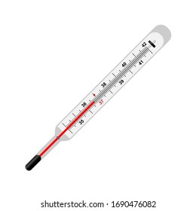
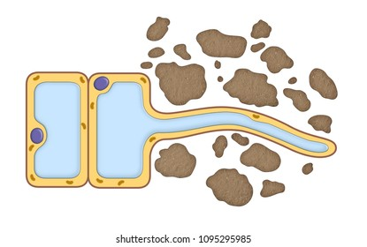
Intent: All life on Earth shares a fundamental goal; to learn, survive and thrive.
Separate Biology KS4 Learning Journey
YEAR
12
GCSE Ecology
Ecosystems, materials and cycling, animal and plant interactions, abiotic and biotic factors. Sustainability, and threats to biodiversity.
GCSE Genetics and Inheritance
YEAR
GCSE Homeostasis
11
Meiosis and mitosis, cellular DNA and its function, genetic inheritance and disorders, evolution and speciation, gene technologies.
Interpreting stimulus and co-ordinating responses within the nervous and endocrine system, reproduction, contraception and fertility,
GCSE Bioenergetics and Plants
Pathogens are microorganisms causing infectious disease, treatment and prevention, vaccinations and drug trials. In humans and plants.
Plant tissues, organs and systems, photosynthesis and respiration,
rates, exercise and metabolism.
Transpiration and translocation.
GCSE Infection and Response
GCSE Organisation of Animals
Principles of organisation of the human body, digestion using enzymes and nutrition.
YEAR
10
GCSE Cell Biology
Exploring structural differences and functionality of cells within organisms. Cell division by mitosis and then specialisation and differentiation.
GCSE Circulation and Health
YEAR
9
Blood and circulatory system,
the respiratory system, CHD,
cancer and non-communicable
diseases and medical treatments.

Slide 10
Intent:
Separate Chemistry KS4 Learning Journey
YEAR
12
GCSE The atmosphere
GCSE Using our resources
The Earth’s atmosphere is dynamic and ever changing. This is as a result of human interference and natural cycles.
The study of corrosion, alloys, ceramics, polymers, composites and the Haber process to make fertilisers.
GCSE Chemical analysis
GCSE Polymers
GCSE Organic reactions
The use of chemical reactions or instrumental methods to identify chemicals and analyse mixtures.
Man-made an natural polymers, including nylon and DNA.
An extended study of the chemistry of compounds where the main element is carbon.
YEAR
GCSE Energy changes
11
GCSE Rates and equilibrium
GCSE Crude oil and fuels
The transfer of energy during chemical reactions. The use of these transfers in batteries and fuel cells.
Determining the effect of variables on reaction speeds and the direction they run.
An introduction to the chemistry of carbon compounds using crude oil as a starting point.
GCSE Electrolysis
GCSE Chemical calculations
GCSE Chemical change
The use of electricity in the decomposition of ionic compounds.
The determination of the composition of chemicals and how this affects their reacting quantities.
Investigating chemical reactions such as displacement in a logical and systematic way.
GCSE Atomic Structure
GCSE Covalent compounds
GCSE Ionic compounds and metals
How history has shaped our understanding of the periodic table, atoms and their reactions.
The study of the element carbon. How it and other non-metals react.
The structure of metals and how they react with non-metals.
YEAR
10
YEAR
GCSE Earth’s Resources
9
How chemists seek to minimise the use of limited resources such as energy and water, managing the environmental impact of human activity.

Slide 11
Intent: Understanding the natural world today, so we can develop new ideas for the future.
Trilogy Physics KS4 Learning Journey
YEAR
12
GCSE Electromagnetism
How magnets work, motor effect, magnetic fields.
Motion graphs, acceleration, SUVAT, terminal velocity, momentum, car safety.
GCSE Waves
GCSE Motion
Wave types, wave properties, EM spectrum; its uses and dangers.
Motion graphs, acceleration, SUVAT, terminal velocity, momentum, car safety.
GCSE Forces
YEAR
GCSE Radiation
11
Atoms, isotopes, types of radiation, fission, fusion, half-life and radiation uses.
GCSE Electricity
GCSE Particles
Circuit symbols, charge, current, voltage, resistance, power, circuit types and domestic electricity.
Solids, liquids and gases. State changes, density, specific heat capacity, latent heat and insulation
YEAR
10
GCSE
Energy stores, energy transfers, calculating energy changes, power and efficiency.
GCSE energy resources
YEAR
9
Energy usage and how it is affected by political, economic and scientific issues. The environmental impact of using energy, how renewable and non-renewable energy sources and the advantages and disadvantages of using them.

Slide 12
Intent: All life on Earth shares a fundamental goal; to learn, survive and thrive.
Trilogy Biology KS4 Learning Journey
YEAR
12
GCSE Ecology
Ecosystems, materials and cycling, animal and plant interactions, abiotic and biotic factors. Sustainability, and threats to biodiversity.
GCSE Genetics and Inheritance
YEAR
GCSE Homeostasis
11
Meiosis and mitosis, cellular DNA and its function, genetic inheritance and disorders, evolution and speciation, gene technologies.
Interpreting stimulus and co-ordinating responses within the nervous and endocrine system, reproduction, contraception and fertility,
GCSE Bioenergetics and Plants
Pathogens are microorganisms causing infectious disease, treatment and prevention, vaccinations and drug trials. In humans only.
Plant tissues, organs and systems, photosynthesis and respiration,
rates, exercise and metabolism.
Transpiration and translocation.
GCSE Infection and Response
GCSE Organisation of Animals
Principles of organisation of the human body, digestion using enzymes and nutrition.
YEAR
10
GCSE Cell Biology
Exploring structural differences and functionality of cells within organisms. Cell division by mitosis and then specialisation and differentiation.
GCSE Circulation and Health
YEAR
9
Blood and circulatory system,
the respiratory system, CHD,
cancer and non-communicable
diseases and medical treatments.

Slide 13
Intent:
Trilogy Chemistry KS4 Learning Journey
YEAR
12
GCSE Chemical analysis
GCSE The atmosphere
The use of chemical reactions to identify chemicals and analyse mixtures.
The Earth’s atmosphere is dynamic and ever changing. This is as a result of human interference and natural cycles.
GCSE Crude oil and fuels
GCSE Rates and equilibrium
An introduction to the chemistry of carbon compounds using crude oil as a starting point.
Determining the effect of variables on reaction speeds and the direction they run.
YEAR
11
GCSE Electrolysis
GCSE Energy changes
The use of electricity in the decomposition of ionic compounds.
The transfer of energy during chemical reactions.
GCSE Chemical calculations
GCSE Chemical change
The determination of the composition of chemicals and how this affects their reacting quantities.
Investigating chemical reactions such as displacement in a logical and systematic way.
GCSE Atomic Structure
GCSE Covalent compounds
GCSE Ionic compounds and metals
How history has shaped our understanding of the periodic table, atoms and their reactions.
The study of the element carbon. How it and other non-metals react.
The structure of metals and how they react with non-metals.
YEAR
10
YEAR
GCSE Earth’s Resources
9
How chemists seek to minimise the use of limited resources such as energy and water, managing the environmental impact of human activity.

Slide 14
KS5 Sciences
(separated by course)

Slide 15
Intent: All life on Earth shares a fundamental goal; to learn, survive and thrive.
A Level Biology KS5 Learning Journey
On to
Post 18
Organisms Respond to Change
Gene Expression
Homeostasis, survivability, taxes and kineses, heart rate, nervous coordination, negative feedback systems, blood glucose and water.
Regulation of transcription and translation, cancer, stem cells, genome projects and gene technologies.
Energy Transfers
Populations and Ecosystems
YEAR
Photosynthesis, Respiration, nutrient cycles, energy transfers and efficiency.
13
Evolution, inheritance, speciation and natural selection, allele frequency, Hardy-Weinberg calculations, communities.
Organisms Exchange
Genetic Information
Mass transport systems, internal and external environments exchange surfaces, particle movement.
Biodiversity, variation, natural selection, evolution, mutations, Index of Diversity,
Biological Molecules
Cell Biology
YEAR
Biochemistry, organic compounds for biological structures and functions.
12
Life exists as cells, features, eukaryotes, prokaryotes, cell division, immunity and cell recognition.
Separate Higher Biology GCSE
Trilogy Higher Science GCSE

Slide 16
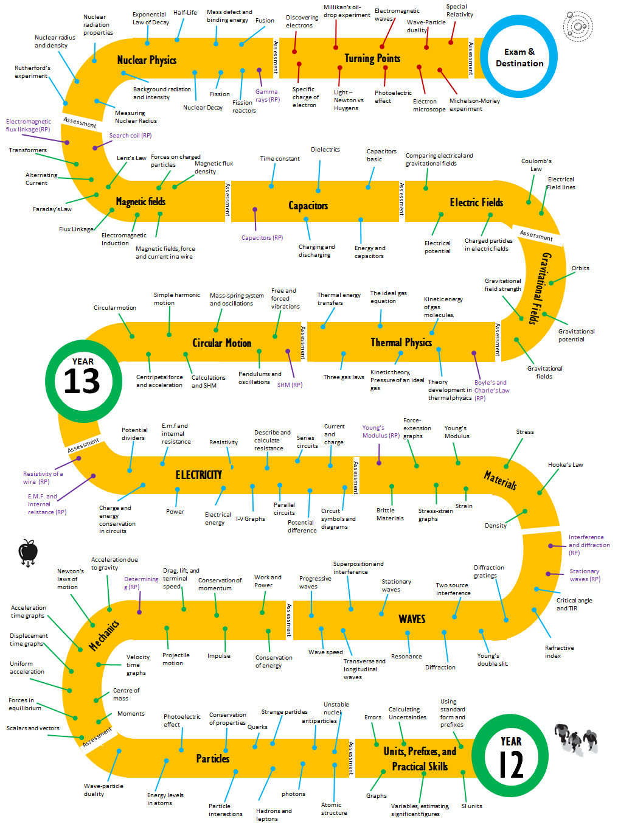
Intent:
A Level Physics KS5 Learning Journey

