Slide 1
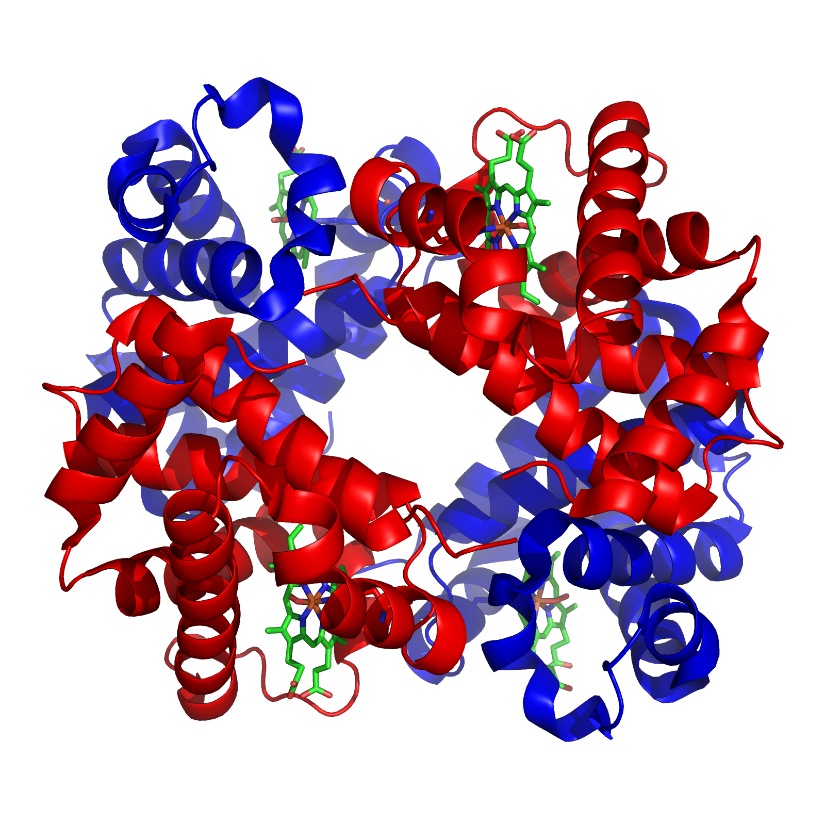
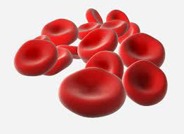
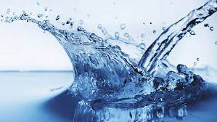
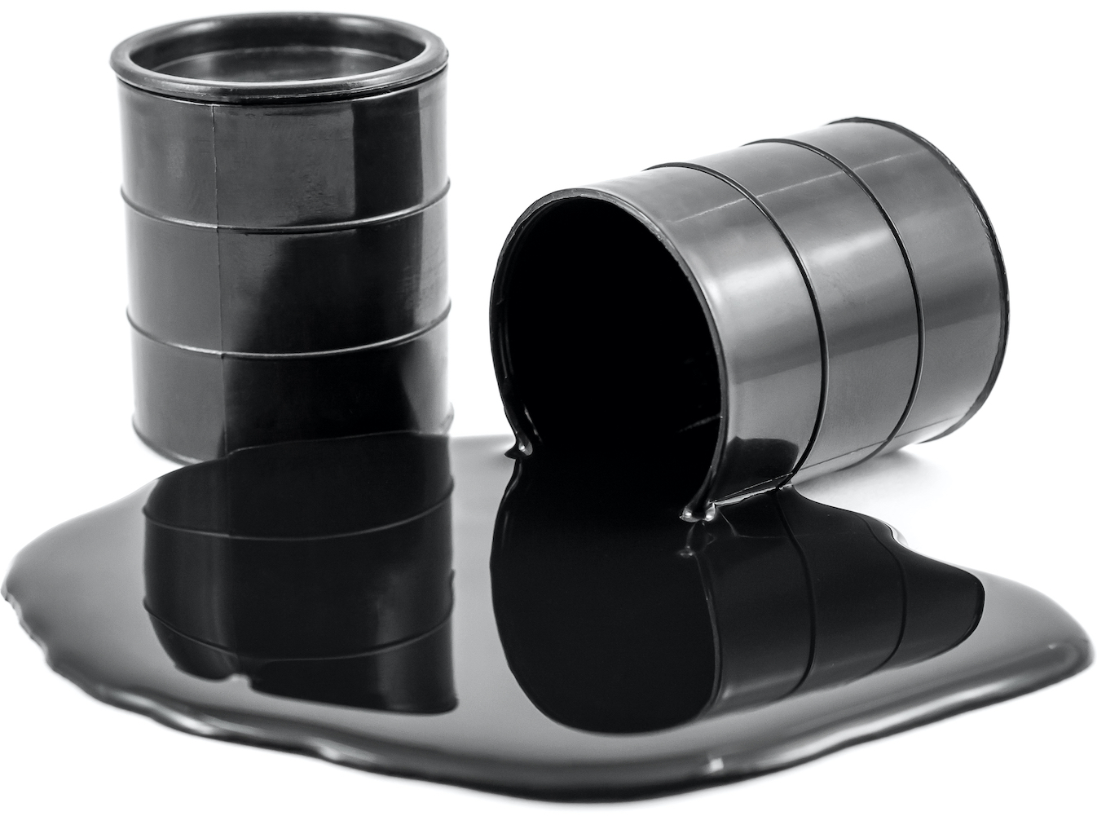
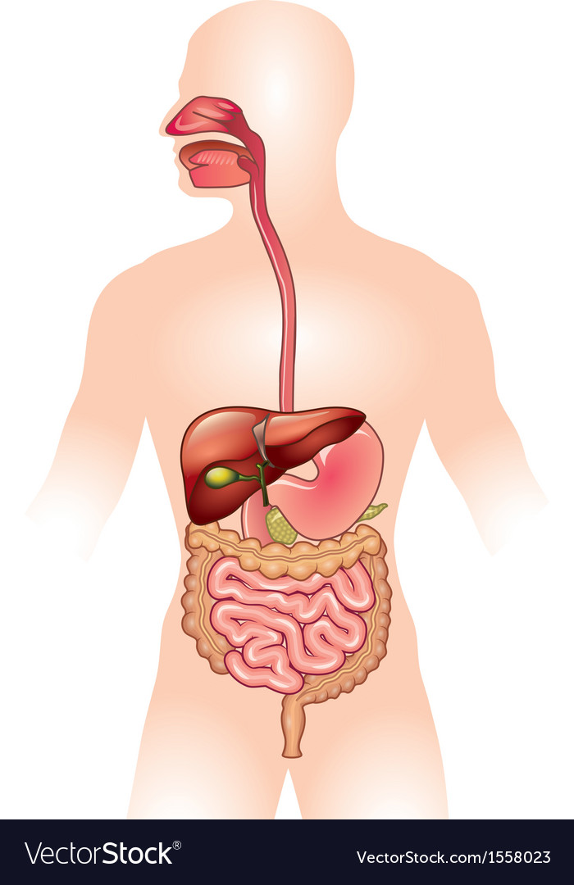
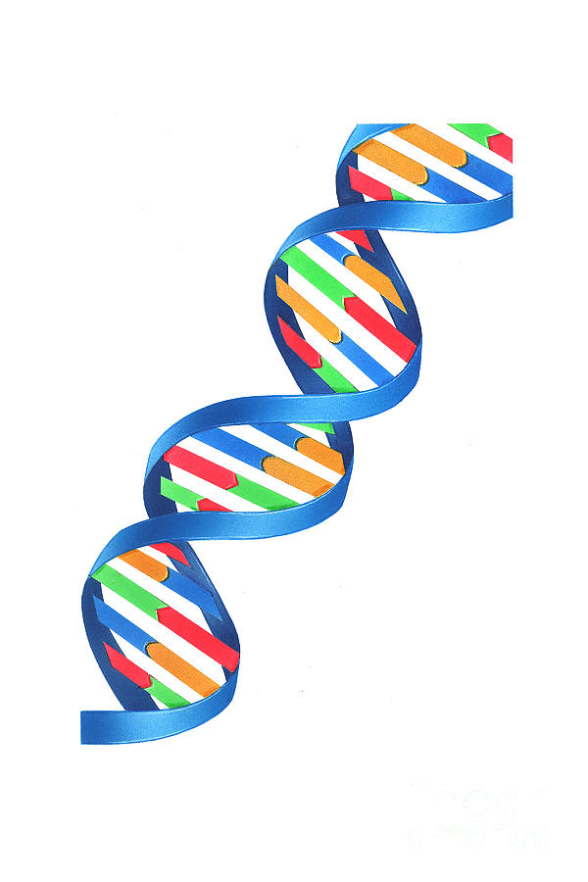
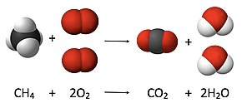
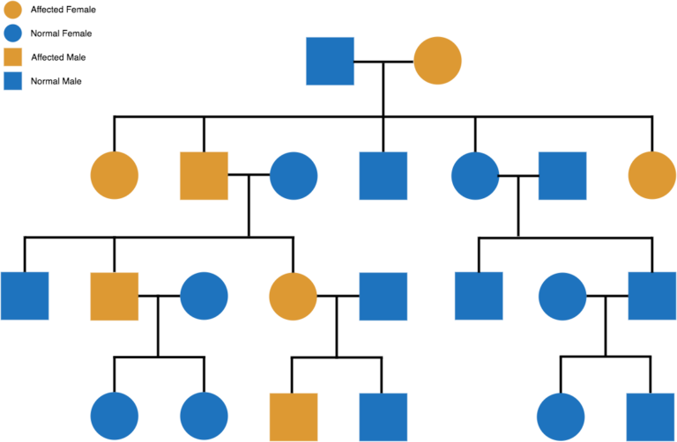
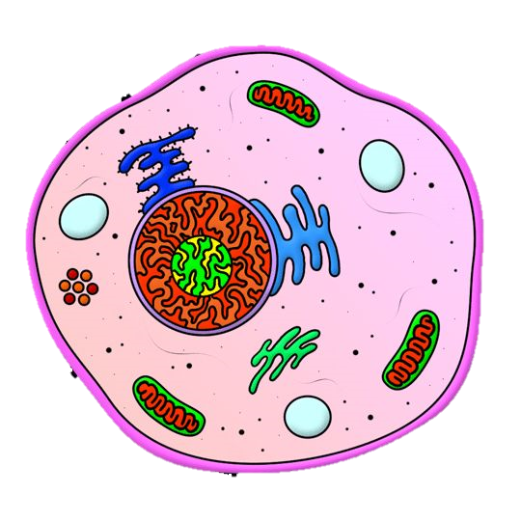
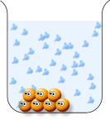
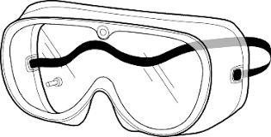
Intent: Making the world go round with learning for today, tomorrow and the future
Science KS3 Learning Journey
YEAR
10
GCSE Circulation and Health
GCSE Earth’s Resources
GCSE Energy Resources
Blood and systems, non-communicable
diseases and treatments.
How chemists seek to minimise the use of limited resources such as energy and water, managing the environmental impact of human activity.
Energy usage and how it is affected by political, economic and scientific issues. Renewable and non-renewable energy sources and the advantages and disadvantages.
Practical Skills
Separating Mixtures
YEAR
Biological Processes
9
Understanding decimals, SI units, Graph drawing, calculating means, variables, range and resolution.
Applying different physical methods to separate different types of mixtures including an in depth look at the chemicals obtained from separating crude oil.
Photosynthesis, respiration, limiting factors, diffusion.
Sound, frequency, amplitude, how we hear, light, colour, reflection and refraction.
Acids and Metals
The Earth
Forces
Waves
Acids and alkalis: how we identify them, how they react and the patterns they show.
How science and geography
combine, how rocks and the atmosphere develop.
Types of forces, weight, mass, friction, resultant forces, how planes fly, magnets and making electromagnets.
Keeping a balanced die, health impacts, the digestive system, and enzymes.
Chemical Reactions
DNA and Evolution
Reproduction
Nutrition
Different types of reactions and how we write them as equations.
Genetics, inheritance, mutations, natural selection, evolution, evidence and fossils.
Pollination, fertilisation, seed dispersal, female and male human reproduction.
YEAR
8
Elements, Compounds and Mixtures
Energy and Electricity
Temperature and Energy
Particles and Matter
What is everything made of and how it behaves. How dissolving works.
Materials and the periodic table, element symbols. How we separate mixtures.
Types of energy stores and how its transferred. Making electrical circuits, light bulbs and lighthouse challenge.
How to use a thermometer, state changes, expansion, heat, conduction, convection and radiation.
YEAR
Interdependence and Variation
Cells and Organisation
Working Like a Scientist
7
Organism interactions, and human impacts, genetics introduction.
Animals and plants, cells and organisms, viewing structures and functions.
Working safely, using a Bunsen, choosing variables, drawing graphs, completing experiments

Slide 2
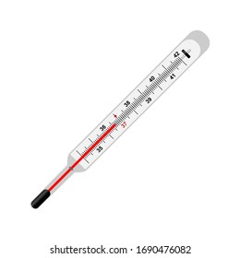
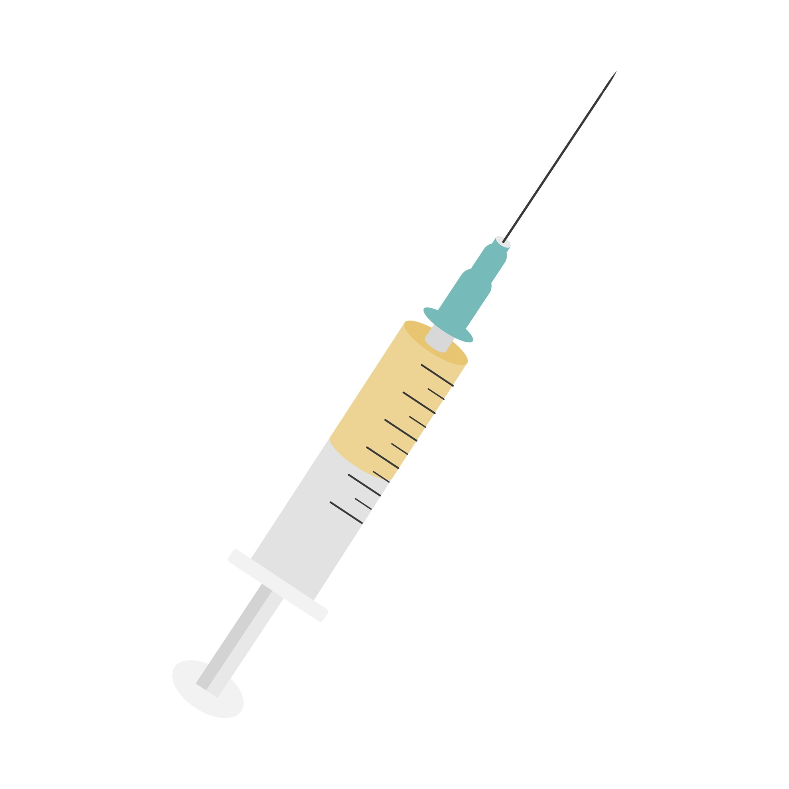
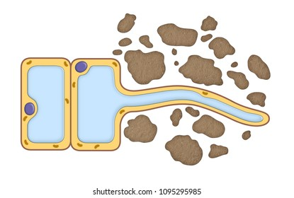
Intent: All life on Earth shares a fundamental goal; to learn, survive and thrive.
Separate Biology KS4 Learning Journey
YEAR
12
GCSE Ecology
Ecosystems, materials and cycling, animal and plant interactions, abiotic and biotic factors. Sustainability, and threats to biodiversity.
GCSE Genetics and Inheritance
YEAR
GCSE Homeostasis
11
Meiosis and mitosis, cellular DNA and its function, genetic inheritance and disorders, evolution and speciation, gene technologies.
Interpreting stimulus and co-ordinating responses within the nervous and endocrine system, reproduction, contraception and fertility,
GCSE Bioenergetics and Plants
Pathogens are microorganisms causing infectious disease, treatment and prevention, vaccinations and drug trials. In humans and plants.
Plant tissues, organs and systems, photosynthesis and respiration,
rates, exercise and metabolism.
Transpiration and translocation.
GCSE Infection and Response
GCSE Organisation of Animals
Principles of organisation of the human body, digestion using enzymes and nutrition.
YEAR
10
GCSE Cell Biology
Exploring structural differences and functionality of cells within organisms. Cell division by mitosis and then specialisation and differentiation.
GCSE Circulation and Health
YEAR
9
Blood and circulatory system,
the respiratory system, CHD,
cancer and non-communicable
diseases and medical treatments.

Slide 3
Intent: All life on Earth shares a fundamental goal; to learn, survive and thrive.
Trilogy Biology KS4 Learning Journey
YEAR
12
GCSE Ecology
Ecosystems, materials and cycling, animal and plant interactions, abiotic and biotic factors. Sustainability, and threats to biodiversity.
GCSE Genetics and Inheritance
YEAR
GCSE Homeostasis
11
Meiosis and mitosis, cellular DNA and its function, genetic inheritance and disorders, evolution and speciation, gene technologies.
Interpreting stimulus and co-ordinating responses within the nervous and endocrine system, reproduction, contraception and fertility,
GCSE Bioenergetics and Plants
Pathogens are microorganisms causing infectious disease, treatment and prevention, vaccinations and drug trials. In humans only.
Plant tissues, organs and systems, photosynthesis and respiration,
rates, exercise and metabolism.
Transpiration and translocation.
GCSE Infection and Response
GCSE Organisation of Animals
Principles of organisation of the human body, digestion using enzymes and nutrition.
YEAR
10
GCSE Cell Biology
Exploring structural differences and functionality of cells within organisms. Cell division by mitosis and then specialisation and differentiation.
GCSE Circulation and Health
YEAR
9
Blood and circulatory system,
the respiratory system, CHD,
cancer and non-communicable
diseases and medical treatments.

Slide 4
Intent: All life on Earth shares a fundamental goal; to learn, survive and thrive.
A Level Biology KS5 Learning Journey
On to
Post 18
Organisms Respond to Change
Gene Expression
Homeostasis, survivability, taxes and kineses, heart rate, nervous coordination, negative feedback systems, blood glucose and water.
Regulation of transcription and translation, cancer, stem cells, genome projects and gene technologies.
Energy Transfers
Populations and Ecosystems
YEAR
Photosynthesis, Respiration, nutrient cycles, energy transfers and efficiency.
13
Evolution, inheritance, speciation and natural selection, allele frequency, Hardy-Weinberg calculations, communities.
Organisms Exchange
Genetic Information
Mass transport systems, internal and external environments exchange surfaces, particle movement.
Biodiversity, variation, natural selection, evolution, mutations, Index of Diversity,
Biological Molecules
Cell Biology
YEAR
Biochemistry, organic compounds for biological structures and functions.
12
Life exists as cells, features, eukaryotes, prokaryotes, cell division, immunity and cell recognition.
Separate Higher Biology GCSE
Trilogy Higher Science GCSE

